Slide 1
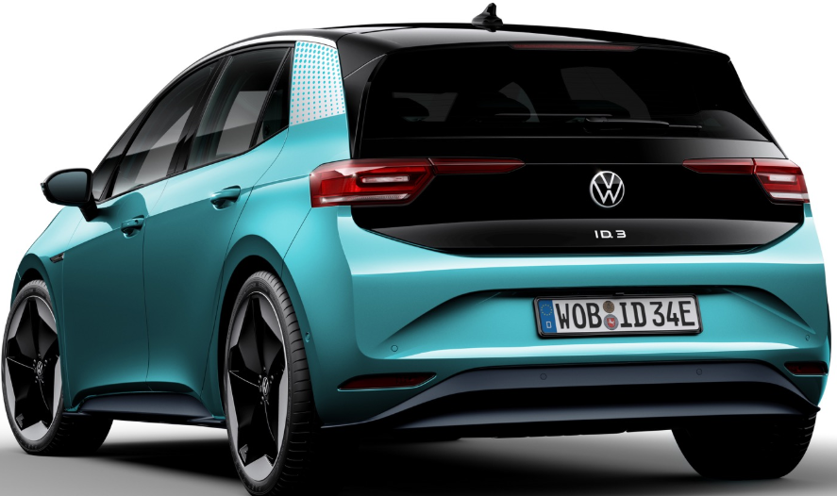
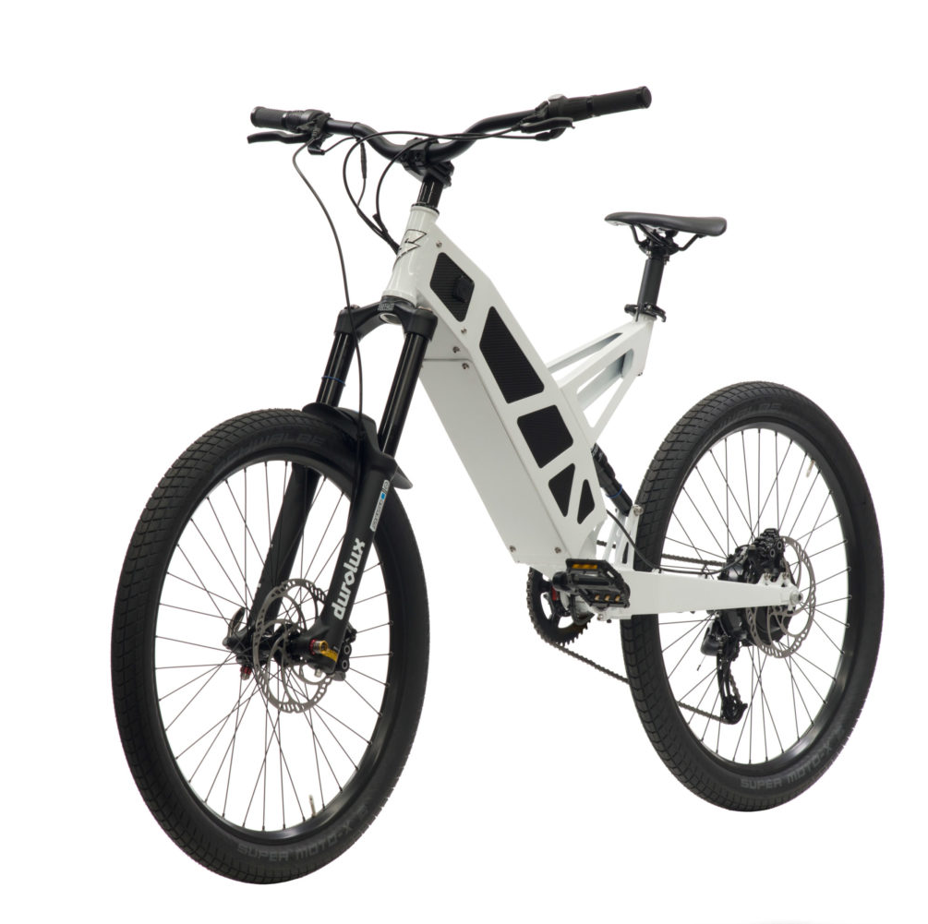
E-Car and E-Bike catalyst
Notes:
Hi I’m Craig Broadbent founder of Auxtail.
Today I’d like to present a system that can combine E-cars and E-Bikes to gain further benefits and to reduce some of their disadvantages of these new technologies.
A Catalyst for E-Car and E-Bike Adoption.

Slide 2
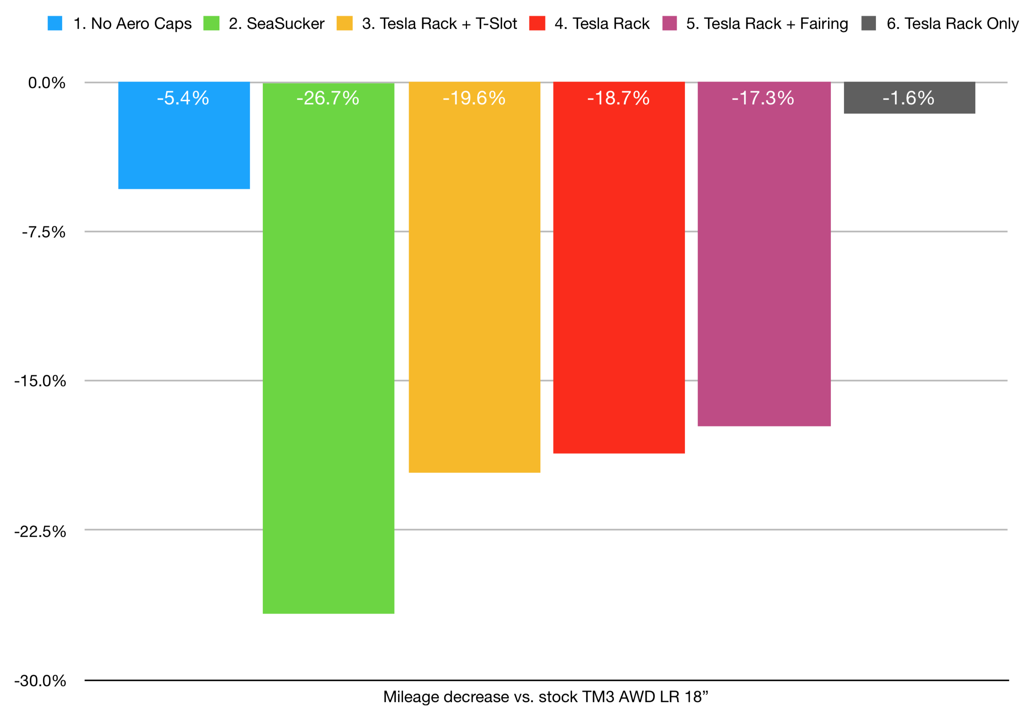
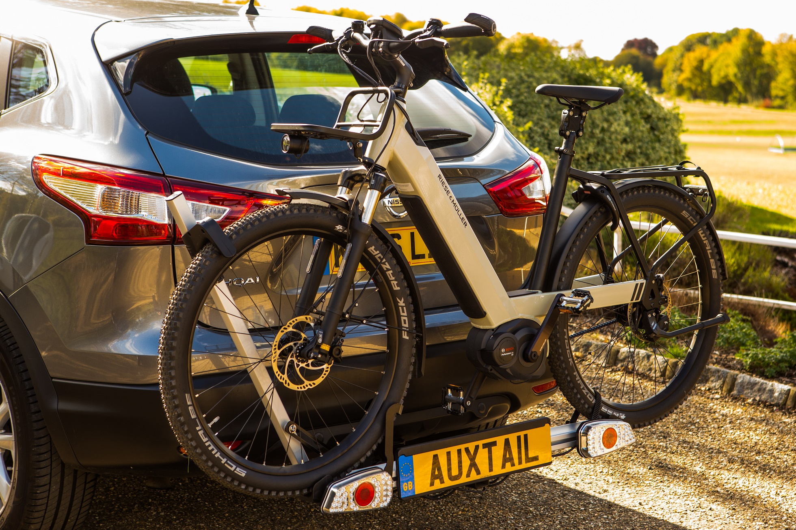
Problem
E- Cars range anxiety
Aerodynamics and mass determine range
Roof loads seriously inhibit aerodynamics
Towing impacts aero and mass (>50% loss in range)
Renault Zoe & BMWi3 prohibit towing and roof loads
E-Bikes carrying issues
Battery and Motor adds 5Kgs to bikes
Wide tyres, mudguards, lights and racks often included
Batteries are fixed to frame limiting traditional carrier clamping places

Slide 3
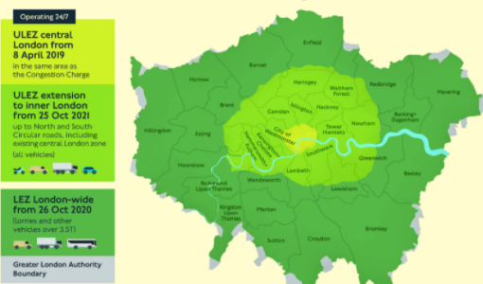
Private Transport
Cities
Not for private cars
How to travel?
E-Bikes
Fast and comfortable
19 mile average one-way London commute
How to go further?
What, When and Where
Multimodal fails at the transitions
How to make seamless?
Notes:
Cities are changing. Mayor Hidalgo in Paris has shown that pro-bike policies can be popular. She was recently reelected. A network of segregated bike lanes are being rapidly rolled out. A segregated network enables young and old, and more women to feel safe. Copenhagen and Denmark provide a model to look forward to.
E-Bikes offer fast and comfortable transport for many. Faster average speeds; Further without Sweating. There is no ned for special clothing. Fat tyres, suspension, integrated lights and full mudguards improve comfort bridging the gap to cars. But these are heavier and more expensive than the traditional bikes.
Car culture has baked in long commutes in cities with urban sprawl. In the UK the average one-way commute is 9 miles. For major cities it is more. In London it is 19. Safe cycling infrastructure rarely leaves the city bounds.
Park and Pedal is growing organically in Oxford and Cambridge in the UK, and Boston USA.
Customers demand 24/7 service to everywhere, with reliability, speed and comfort. Private cars can provide the first leg and private E-bikes the last leg and we need to make the connection fast and painless. Leaving an E-Bike at the hub is unattractive due to security risk. Thus taking your bike with you is preferred. Putting an e-bike on the roof into a car are impractical for most suggesting a rear rack is the best way forward.

Slide 4
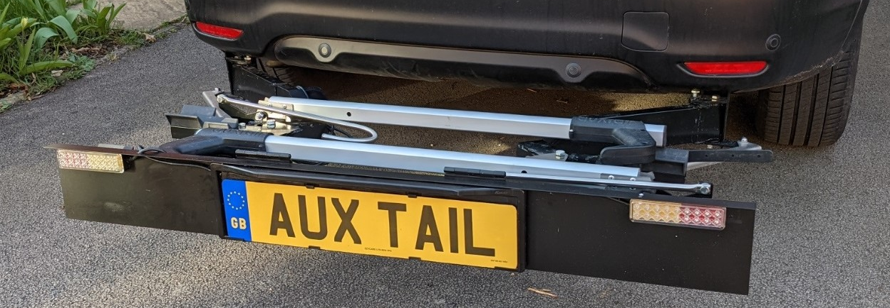
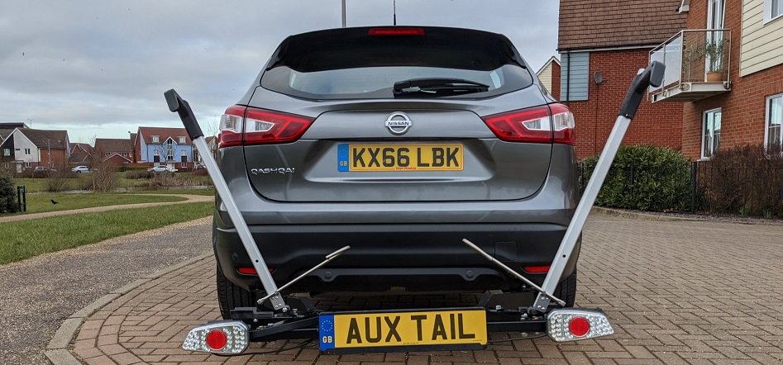
Seamless
Your bike
When you need
Where you want
Current
No Finisher
300mm in vehicle length
2 E-bike capability
Future
In bumper/ finisher
230mm in vehicle length
4 bike capability (with extension)
Notes:
Multimodal systems are rare and not normally successful. 2 Modes are better tan 3, as a failure of one mode is a system failure. By providing 2 private modes, reliability is assured or at least it is your responsibility.
The bike and car are your personal choice. Whilst we are targeting E-bikes, it may be that you want to exercise.
The transitions are usually where pain is experienced. For this system a car parking space is required. At the outskirts of cities these are usually not too dear and some are offered free to encourage less car use. Multistory and low entry barriers do discourage roof carrying systems. The great flexibility of only needing parking will often allow for multiple options. This may offer some flexibility with traffic conditions, weather or a desire for a different scene.
Current prototype uses a tyre grip system similar to US hitch racks from Kuat, Thule and Yakima. It is currently able to safely carry 2 standard (15Kg) bikes. Loading and unloading is fast. The stored rack protrudes from the lower bumper and the operation of deploying the rack is manual.
The next parts will reduce the height and depth of the system by 20mm. This will allow for in bumper designs. We also have designs to make the rack significantly stronger, and allow for automatic deployment with manual retraction. A new set of lights would reduce the package depth further and a cover would tidy up the appearance.

Slide 5
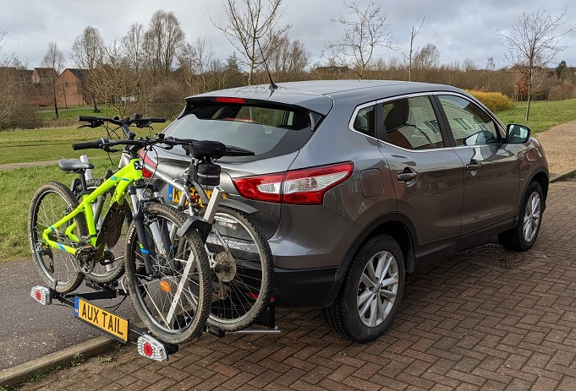
Market
E-Cars sales growing 30% pa
30% sales by 2030 (Ref. IEA)
Key Performance is range
E-Bike market growing 23% per year (Ref. ECF)
$46Bn by 2026 (https://www.ft.com/content/0e2730c4-6d2f-49a1-be41-875710385a39)
E-Bikes 17% of all bike sales by volume in Europe (2019)
Car-based bike rack market growing at 7% per year
Worth $4Bn https://www.mordorintelligence.com/industry-reports/car-rack-market. https://www.zionmarketresearch.com/report/automobile-roof-racks-market
1/3 of towbar https://www.factmr.com/media-release/1525/automotive-tow-bars-market-trends.
Currently dominated by aftermarket but growing OEM
Notes:
The climate crisis has pushed many countries to make commitments to decarbonise. This is driving transport regulation. Subsidies are being offered in many countries to adopt clean transport. Electric Vehicles offer a fast route to decarbonise and are expected to be to dominate private vehicle sales in the not so distant future.
To compete in the electric vehicle market you need good range. However batteries make up about 50% of the purchase price. So adding batteries is not attractive. The only way to get more range for the same battery size is to improve efficiency. Aerodynamics is the largest single factor consuming 40-50% of a battery energy. It is no accident that most electric cars don’t offer a roof rack. E-Cars are poor for towing with 50% range being common
E-bikes are outselling E-Cars, especially in cities with over 3 million sold in Europe in 2019. Lithium Ion Batteries are again the key technology getting ever cheaper and lighter.
Where E-cars need to be more efficient, the reverse is true for E-Bikes where their power enables bikes to go faster, further and allow for more comfort at the same time. All these comforts, batteries and motors however make E-bikes heavy and expensive. The size and mass make carrying by car more difficult.
13% of cars get a bike rack. This is a similar adoption rate to towbars. Towbars are mainly sold by the car manufacturers where bike racks are mainly aftermarket. Towbars have changed from fixed to removable, then hidden and now automatic. Prices in excess of $2000 are paid for automatic towbars in Europe with large profit margins, making these a very important part of the manufacturer’s business plan... Without roof rack or towing the vehicle sale can become unattractive. External load carrying capability is an important feature. A large rear rack, especially one suitable for E-Bikes offers an important potential profit stream.

Slide 6
Business Case
Pricing
Retail £800+ (2 E-Bike)
Cost
£350- (2 Bike)
Bike carrier application rate
13% (C Segment)
Personalisation Opportunities (Aftermarket)
3, 4 & 5 bikes
Cargobox
Step (Dogstep)
Ski rack
Notes:
Rear bike rack systems sold by car manufacturers cost in excess of $1000. The prices rise to $1800 on the VW ID3. None of these are integrated on to the vehicle. All require a rack to be loaded and locked into place. Usually these racks weigh over 15Kg and take significant time to secure. Most are fitted a towball. A single load path which is load limited to 60Kg (2 E-Bikes or 3 standard ones).
Auxtail’s rack is permanently fixed to the vehicle on both sides. The rack locks into stored and deployed positions at both sides.
The Auxtail system offers good value for car sales channels, where we can produce at less than $400. We note that most accessories for towing are sold in the aftermarket although most towbars are sold by the manufacturers. We propose a similar business model. Get the racks out there at cost and sell the options directly. The sales of bike extensions should 50% of rack sales in volume terms.
The rack fixes to the platform of the vehicle. VW is planning 27 models on its MEB platform. We would expect that one rack could be sold for all 27 vehicles, although this would need collaboration with VW and its subsiduaries.
This is our long term aim.

Slide 7
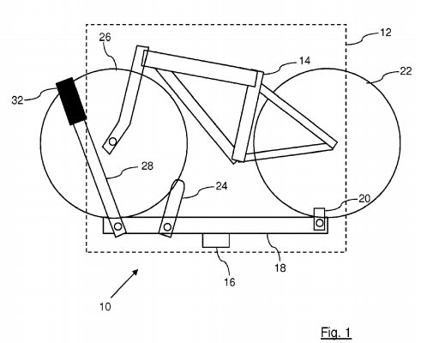
Unique Selling Points
ducts
Time
Fastest bike loading, seconds to load
Safety
Failsafe Design- 2 load paths
Integration
Invisible feature
No range degradation
High Load
70 Kg dynamic
4 bike capability with extension
European patent granted EP3375667A1
Other patents filed.
Notes:
We believe that our system offers many advantages over current options.
With the rack permanently fitted and deploying automatically, preparation time is reduced. The tyre grip rack is faster with just 2 ratchets to secure the load. The rack locks into position such that user error are mostly eliminated and the philosophy of failsafe is employed throughout with multiple load paths.
By having a rack permanently on the car, the city is accessible from rural residences and vice versa. The integration into the bumper means the aerodynamics are not hindered when stored and minimal when carrying.
The high load strength enables heavy E-Bikes or a full family of standard bikes to be carried. There is also potential for other load carrying and a useful step/seat capability too.
We have a granted patent and are pursuing further patents.
We are fully versed in car regulation. And understand the needs and wants of cyclists and Ebike converts.
We have a good grasp of the changes happening due to electrification and are fully conversant in the decarbonisation journey.

Slide 8
Team
Craig Broadbent – Founder
20 years Automotive Design for Nissan Technical Centre Europe
Structures, Bumpers and Accessories, including towbars and bike carriers
Cycling Advocate
BEng and MBA
Paul Garside – Mentor
10 Years Director Nissan Europe
30 years Automotive Industry
Including Business Project Management, Quality And Customer Experience

Slide 9
Next Steps
Market
UK
Northern Europe
Finance £400K for Assembly/Development centre
Team building
Tooling
Stock build
Marketing and sales
Assembly facilities
Partnerships
OEM or National Sales Companies
Supplier

